Slide 1
Visual studio 2010 web.config transformation
Jay Smith – Tyson Foods, Inc.
Notes:
Introduction
Name: Jay Smith
Work: PMO Architect and Evangelist
The main goal of this presentation is to look at how Visual Studio 2010 has improve the deployment story for web applications. I understand that many corporate environments are like where I work and it may be a while before we can adopt Visual Studio 2010. So on the way we are going to look at some techniques we use today to ease the deployment woes, and finally look at how Visual Studio 2010 makes our like easier.

Slide 2
Agenda
The Corporate Development Environment
Deployment Challenges
Deployment Strategy 1
Deployment Strategy 2
VS 2010 Web.config Transformations
Notes:
So here is what we are going to discuss,
A quick overview of what the corporate development environment looks like at Tyson Foods.
Discuss the challenges of deploying web applications
Then we are going to look at a few solutions we use at Tyson Foods to deploy web applications, neither are perfect but do have some advantages
The finally we will jump into Visual Studio 2010 beta 2 and look at the future of web deployment.

Slide 3






The Corporate Environment
IIS7
Developer
Development
IIS7
Test
IIS7
IIS7
Stage
Production
Notes:
To many of you this probably looks familiar,
You develop local either against a local database or development database, then you push you code to the development environment.
I usually work local and then publish to test, for the analyst and end users to look over.
Then you finally publish to Stage or a Pre Production environment so that you IT Administrator can eventually publish it to the production environment.

Slide 4
Deployment Challenges
Database Connection Strings
Membership and Role Configurations
Web Service Endpoints
System Integration Points
Shared Assemblies
Third Party Controls
IIS Settings
File System Paths or File Shares
Notes:
The challenges that we face are getting all the necessary settings, database connection strings, web service endpoints, logging, file system paths etc moved to the new environment correctly so that the application runs as expected.
If anyone of these things are configured wrong you application may not run, which causes you to have to scramble to get the correct files copied to the server.

Slide 5
Multiple Configuration Files
Maintain complete separate configuration files, once for each targeted environment and use ms builds to deploy the correct configuration file based on the build target.

Slide 6
Demo

Slide 7
Once Configuration file + Magic
Maintain a single configuration file with entries for each environment and use a string replace custom build task to set the run time environment on the build target.

Slide 8
Demo

Slide 9
Visual Studio 2010 Solution
Maintain a single configuration file
Use transformation files for each environment
Transformation files only contain the things that change
Works with new MS Deploy
No custom build task

Slide 10





VS 2010 web.config Tranformation
XML Transformation Engine
(Staging Ready)
Web.Staging.Config
Outputted to OBJ\staging folder of your project

Slide 11
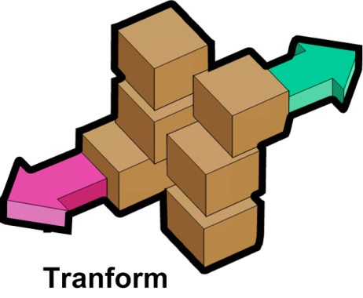


XML Transformation Engine
Web.Staging.Config
(Staging Ready)

Slide 12
DEMO

Slide 13
Summary
MS Build with Visual Studio 2008 can be used to automate your build and deployment
Visual Studio 2010 deployment story is much better.

Slide 14
Resources
MS Build Reference
VS Execute CMD http://devlinliles.com
VS 2010 Web.Config Transformation
PDC VS2010 Presentation
jay@jaysmith.us

